Slide 1
Tutorial 9
Lab 5
15/11/2019

Slide 2
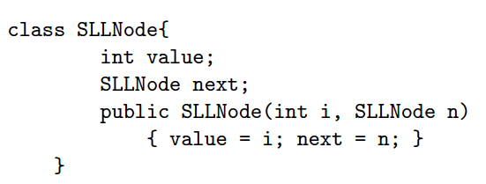
class SLLSet {
int size;
SLLNode head;

Slide 3
Constructor 1.
public SLLSet(){
size =0;
head=null;
}
Constructor 2
public SLLSet( int[] sortedArr){
// check if NUll
else
get the size
Create the head
assign current node.
if length condition satisfy
Create next
}

Slide 4
public boolean isIn(int v){
// linear search to find the value
// could implement a more efficient search algorithm
SLLNode iter = head;
//loop through the list.
// If we find the matching value, it is in the list
// If we come across a value that's larger that the one we are looking for, it is not in the list
// We might still reach the end of the list without finding a matching value, or a value that's bigger than the one we are looking for
}
public SLLSet copy(){
Create a new
//copy the head
//copy the middle elements and the tail
while(iter.next!=null){
//create a copy of the current node
//move to the next node
}

Slide 5
public void add(int v){
SLLNode iter = head;
//Case where new node should be added at the start
//case where new node is already in the list
//case where new node should be added
somewhere in the middle
//if iter's value is less than v, but iter's next
value is greater than v, we found the spot
// have to make sure next node i
//create a new node, and link it to iter.next
//update the current node's next node
//update size
}
public void remove(int v){
//check null list
// check isin
else{
SLLNode iter = head;
//Case where the node we want to delete is the head
else{
//case where the node to delete is in the middle or tail
// find the node to delete. Make the previous node skip over it
if(iter.next.value==v){
//skip over the node
//update size
}

Slide 6
public SLLSet intersection(SLLSet s){
SLLNode iter = this.head;
//go through this list and check if the value also appears in the other list
// if so, add it to the intersection list
// O(n^2)
}
public SLLSet union(SLLSet s){
SLLNode iter = this.head;
//copy all the values from this list
// O(size) aka O(n)
iter = s.head;
//copy all the values from list s
// O(s.size) aka O(m)
}
public SLLSet difference(SLLSet s){
//go through this list and check to make sure the value does not appear in the other list
// if the value is not in the other list, add to difference list
//go through list s and check to make sure the value does not appear in "this" list
// if the value is not in "this" list, add to difference list

